Slide 1
Graphs
[Module – 5]
WCE - SY (CSE) – 1CI 202: Data Structures
Course Teacher: Dr. Smriti H. Bhandari

Slide 2
Graphs
Basic Terminology
Representation of Graphs
  Adjacency Matrix
  Adjacency List
  Adjacency Multilist
Traversals
  Depth first
  Breadth first
Minimum Spanning Tree

Slide 3
Basic Concepts
Non-linear data structure
Definition
  Graph is
    a collection of nodes, called vertices and
    A collection of segments or lines called edges/arcs connecting pairs of vertices

Slide 4
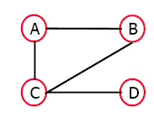
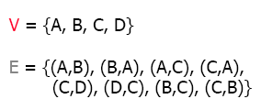
Basic Concepts (2)
Formal definition
  Graph G is a pair (V,E) where
    V is a set of nodes called vertices
    E is a set of pairs of vertices each representing an edge

Slide 5
Basic Concepts (3)
Directed Edge
  Ordered pair of vertices (u,v)
  First vertex u is the origin
  Second vertex v is the destination
Undirected Edge
  Unordered pair of vertices (u,v)

Slide 6
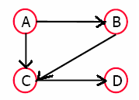
Basic Concepts (4)
Directed graph or digraph
  All the edges are directed
Undirected graph
  All the edges are undirected

Slide 7
Applications
Electronic circuits
  Printed circuit boards
  Integrated circuits
Transportation and communication networks
  Highway network
  Flight network
Computer Networks
  Local area network
  Internet
Databases
  Entity-relationship graph
Modeling any sort of relationships
  Between components, processes, people, concepts etc.

Slide 8
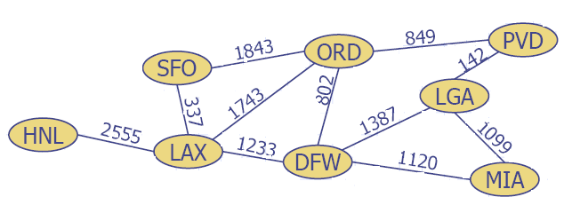
Example – Flight route network
  Edge represents flight route between two airports

Slide 9
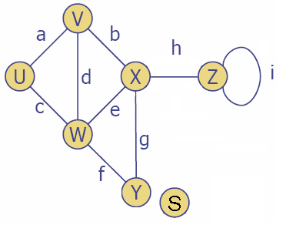
Terminology
End vertices or end points of an edge
  U and V are end points of edge a
Edges incident on the vertex
  a, d and b are incident on V
Adjacent vertices
  Vertex v is adjacent to vertex u iff (u,v) ∈ e
  U and W are adjacent
Degree of a vertex
  Number of edges incident to it or number of adjacent vertices
  X has degree 4
Loops
  Edge having identical end points
  i forms loop at Z
Isolated Node/Vertex
  A node which is not adjacent to any other node
  Degree of isolated node is zero
  S is an isolated node

Slide 10
Terminology – (2)
Path
  A sequence of vertices v₁ ,v₂ ,. . .v_{k} such that v_{i+1} is adjacent to v_{i} for i = 1 .. k – 1
Simple path
  A path with no repeated vertices (i.e. all vertices are distinct)
Cycle
  A path except that the last vertex is same as the first vertex
Simple Cycle
  A simple path except that the last vertex is same as the first vertex
Cyclic graph
  Graph containing a cycle
Acyclic graph
  Graph which does not contain a cycle

Slide 11
Terminology – (3)
Connected graph
  A graph G is connected if and only if there is a simple path between any two nodes in G
Complete graph
  A graph G is said to be complete if every node u in G is adjacent to every other node v in G.
  Always connected
  A complete graph with n nodes will have n(n-1)/2 edges.

Slide 12
Terminology – (4)
Strongly Connected Graph
  A directed graph G is said to be strongly connected, if for each pair u,v of nodes in G there is a path from u to v and there is also a path from v to u
Unilaterally Connected Graph
  Graph G is said to be unilaterally connected if for any pair u, v of nodes in G there is a path from u to v or a path from v to u

Slide 13
Terminology – (5)
Densely Connected Digraphs
  The ratio of number of edges to number of nodes is large
Sparsely Connected Digraph
  The ratio of number of edges to number of nodes is small

Slide 14
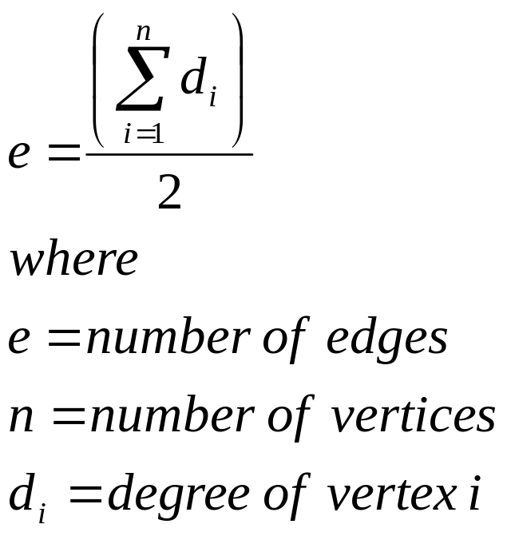
Terminology – (6)

Slide 15
Terminology – (7)
Tree graph
  A connected graph T without any cycles is called a tree graph or tree
  There is a unique simple path P between any two nodes u and v in T
Null graph
  Graph containing only isolated nodes
  Graph containing an empty set of edges
Order of Graph
  The number of vertices

Slide 16
Terminology – (8)
Labeled Graph
  A graph G is said to be labeled if its edges are assigned data
Weighted Graph
  A graph G is said to be weighted if each edge e in G is assigned a nonnegative numerical value w(e) called the weight or length of e.

Slide 17
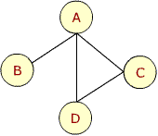
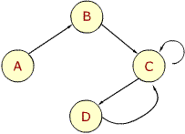
Terminology – (9)
A graph G is called a simple graph if it satisfies the following conditions:
  There are no loops in the graph G. This means, that there does not exist an edge in E of form (V_{i}, V_{i}) for any V_{i} in V.
  There is not more than one edge joining any pair of vertices V_{i} and, V_{j} in V. This means, that there does not exist more than one edge in E of the form (V_{i}, V_{j}).

Slide 18
Representation of Graph
Matrix Representation
List Representation
Multilist Representation

Slide 19
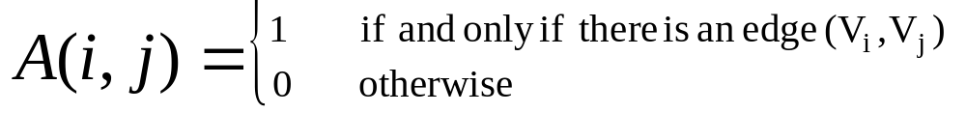
Adjacency Matrix Representation
Consider a graph G with set of vertices V and set of edges E. If there are N nodes in V, for N > = 1, the graph G may be represented by an adjacency matrix which is a table with N rows and N columns where

Slide 20
Adjacency Matrix
If G is an undirected graph, then adjacency matrix A of G will be symmetric matrix
  i.e. for every i and j, A(i,j) = A(j,i)

Slide 21
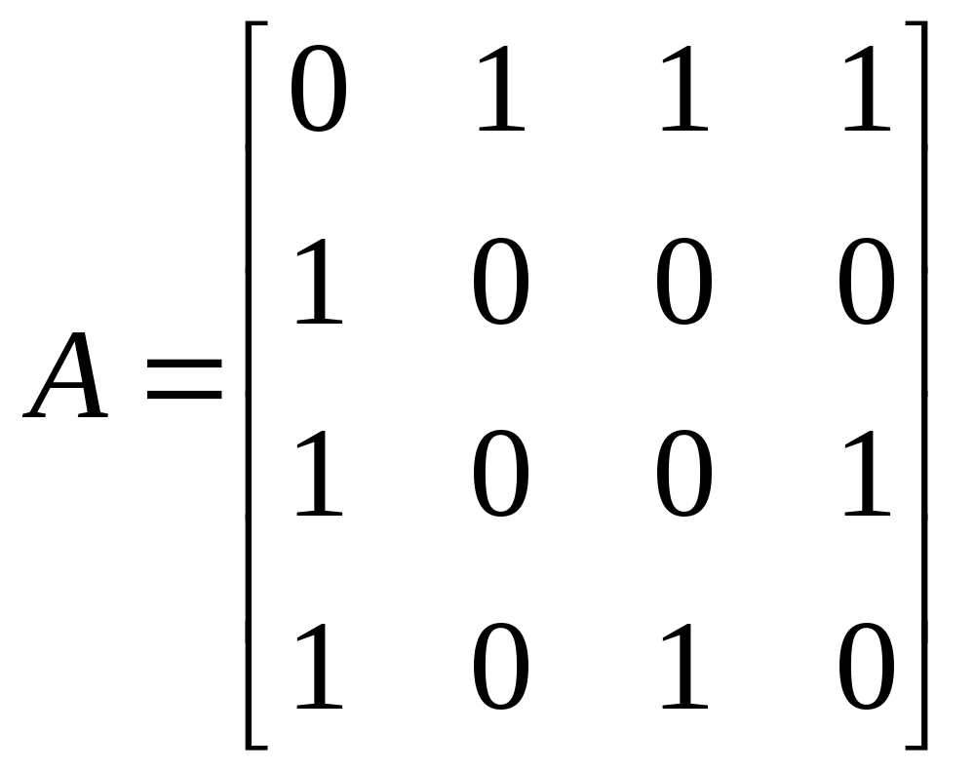
Adjacency Matrix – Example 1
A B C D
A
B
C
D

Slide 22
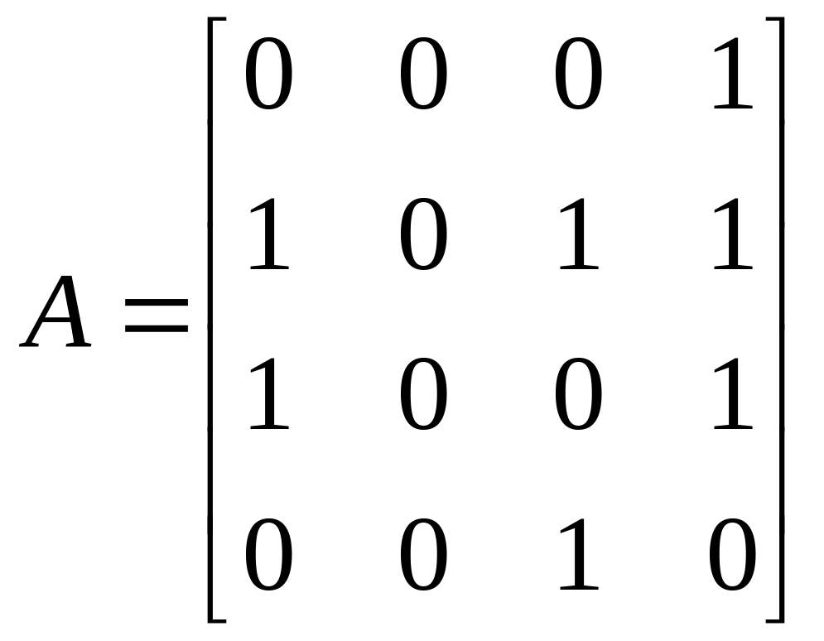
Adjacency Matrix – Example 2
X Y Z W
X
Y
Z
W
Y
X
Z
W

Slide 23
Adjacency Matrix – Observations
X Y Z W
X
Y
Z
W
Y
X
Z
W
i ^{th} row in the adjacency matrix is determined by the edges which start from the vertex V_{i}.

Slide 24
Adjacency Matrix – Observations
X Y Z W
X
Y
Z
W
Y
X
Z
W
The number of elements in the i ^{th} row whose value is 1 is equal to the out degree of the node V_{i}.

Slide 25
Adjacency Matrix – Observations
X Y Z W
X
Y
Z
W
Y
X
Z
W
The number of elements whose value is 1 in j ^{th} column is equal to the in degree of vertex V_{j}.

Slide 26
Adjacency Matrix – Observations
X Y Z W
X
Y
Z
W
Y
X
Z
W
If there are loops at each node but no other edge, then the adjacency matrix is the identity or the unit matrix.

Slide 27
Adjacency Matrix – Observations
X Y Z W
X
Y
Z
W
Y
X
Z
W
For a null graph which has no edges, the adjacency matrix has all its elements as zero. Therefore, its adjacency matrix is a null matrix.

Slide 28
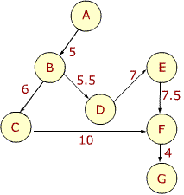
Adjacency Matrix – Example 3
 | A | B | C | D | E | F | G
A | 0 | 5 | 0 | 0 | 0 | 0 | 0
B | 0 | 0 | 6 | 5.5 | 0 | 0 | 0
C | 0 | 0 | 0 | 0 | 0 | 10 | 0
D | 0 | 0 | 0 | 0 | 7 | 0 | 0
E | 0 | 0 | 0 | 0 | 0 | 7.5 | 0
F | 0 | 0 | 0 | 0 | 0 | 0 | 4
G | 0 | 0 | 0 | 0 | 0 | 0 | 0

Slide 29
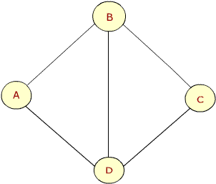
Adjacency Matrix – Example 4
 | A | B | C | D
A | 0 | 1 | 0 | 1
B | 1 | 0 | 1 | 1
C | 0 | 1 | 0 | 1
D | 1 | 1 | 1 | 0

Slide 30
An entry of 1 in the i ^{th} row and j ^{th} column of A in the adjacency matrix of a graph shows that there exists an edge (V_{i} ,V_{j}) that means, there exists a path of length 1 from V_{i} and V_{j}

Slide 31
Proposition
Let A be the adjacency matrix of a graph G. Then A_{k}(i,j) i.e the ij entry in the matrix A^{k}, gives the number of paths of length K from v_{i} to v_{j}.

Slide 32
Example
X Y Z W
X
Y
Z
W
Y
X
Z
W
Compute A², A³, A⁴

Slide 33
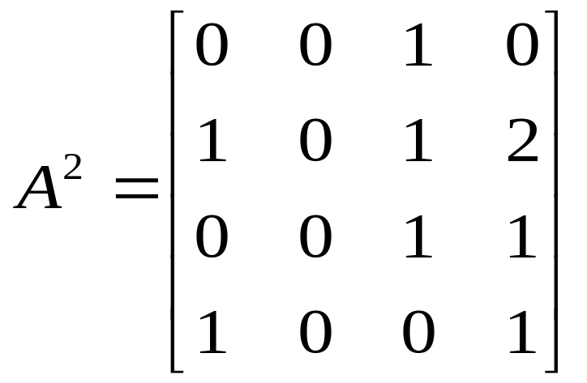
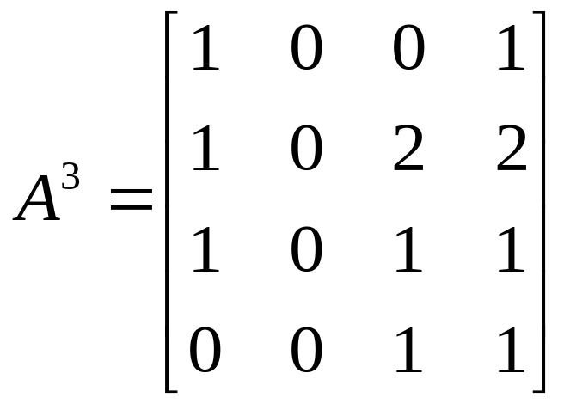
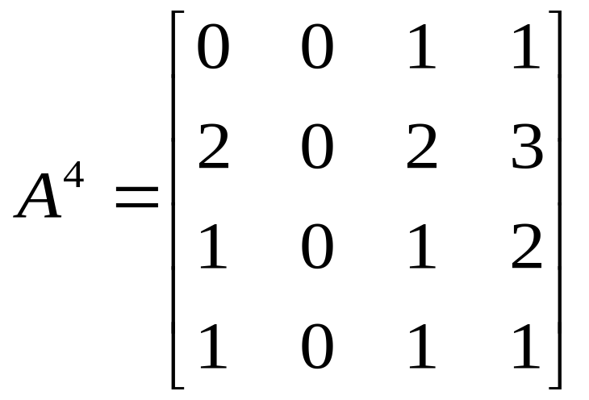
X Y Z W
Y
X
Z
W
There is a path of length 2 from W to X
There are two paths of length 3 from Y to Z and from Y to W
There are three paths of length 4 from Y to W

Slide 34
Proposition
Let us define matrix B_{m} as below:
B_{m} = A + A² + A³ + … + A^{m}
The entry ij of matrix B_{m} gives the number of paths of length m or less from node v_{i} to v_{j}

Slide 35
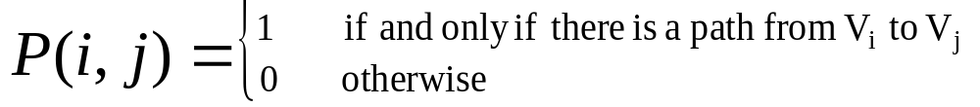
Path Matrix / Reachability Matrix
Let G be the simple directed graph with m nodes v₁,v₂, … v_{m}. The path matrix or reachability matrix of G is the m-square matrix P defined as below:

Slide 36
Proposition
Let A be the adjacency matrix and let P be the path matrix of a digraph G.
Then P(i,j) = 1 if and only if there is a nonzero number in the ij entry of the matrix
B_{m} = A + A² + A³ + … + A^{m}

Slide 37
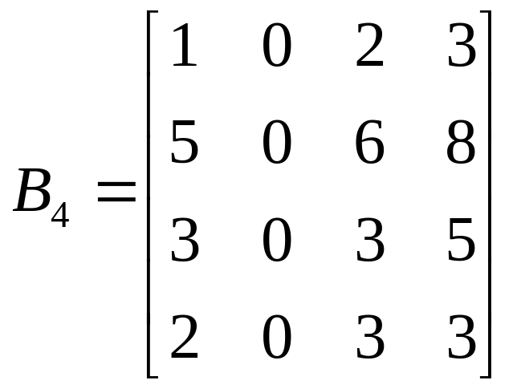
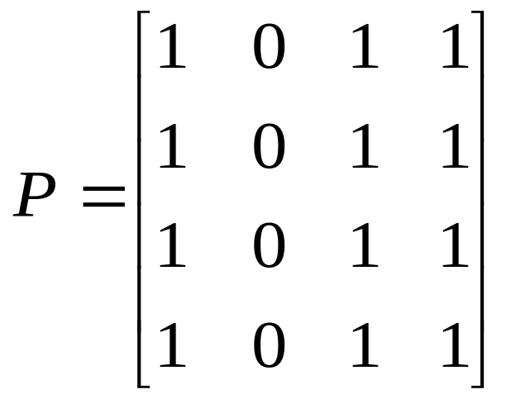
Example
Using earlier example compute B₄ and P
Y
X
Z
W
Node Y is not reachable from any of the other nodes

Slide 38
Observation
Graph G is strongly connected if and only if the path matrix P of G has no zero entries

Slide 39
Drawbacks of Adjacency matrix representation
Static implementation
A priori knowledge regarding number of nodes in the graph is needed
Dynamic changes in the graph are difficult to model
Wastage of space if matrix is sparse
Not possible to store additional information about the graph
Notes:
The adjacency matrix requires storage for each possible edge between each pair of nodes irrespective of the fact whether the edge exists or not. The space must be reserved for every possible edge even if the adjacency matrix is sparse.

Slide 40
Linked Representation
A linked structure that can make allocation and deallocations of nodes dynamically
Also known as adjacency structure

Slide 41
Linked Representation
Graph is represented using adjacency list
➔ For each node, it’s neighbor’s information is maintained in a linked list fashion
Adjacency list stores information about only those edges that exist
The linked representation contains two lists:
  A node list
  An edge list

Slide 42
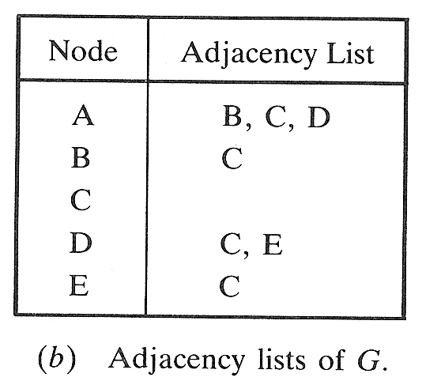
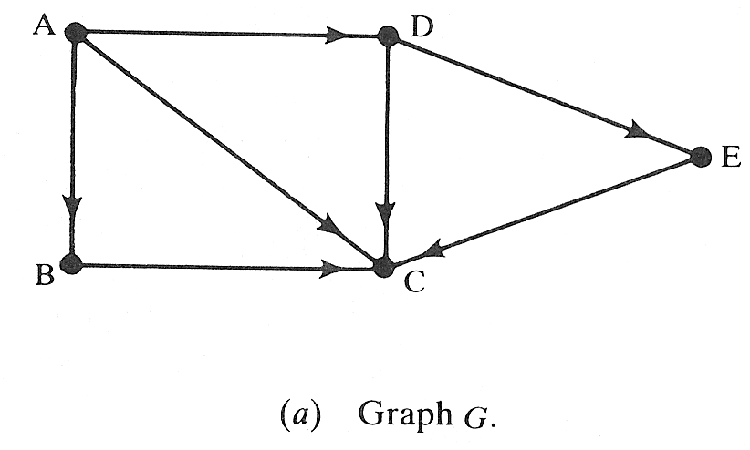
Example

Slide 43
Linked Representation
Node List / Vertex List
Edge List
Name or Key value of the node
Pointer to the next node in list NODE
Pointer to the first element in list EDGE
Other information (if any) e.g. indegree, outdegree, status etc.
Pointer to the location in the list NODE of the destination
To link the edges with the same initial node

Slide 44
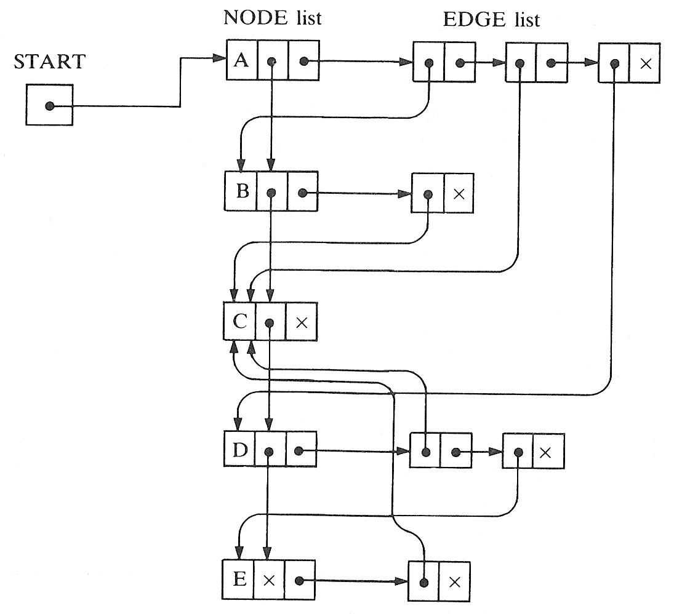

Slide 45
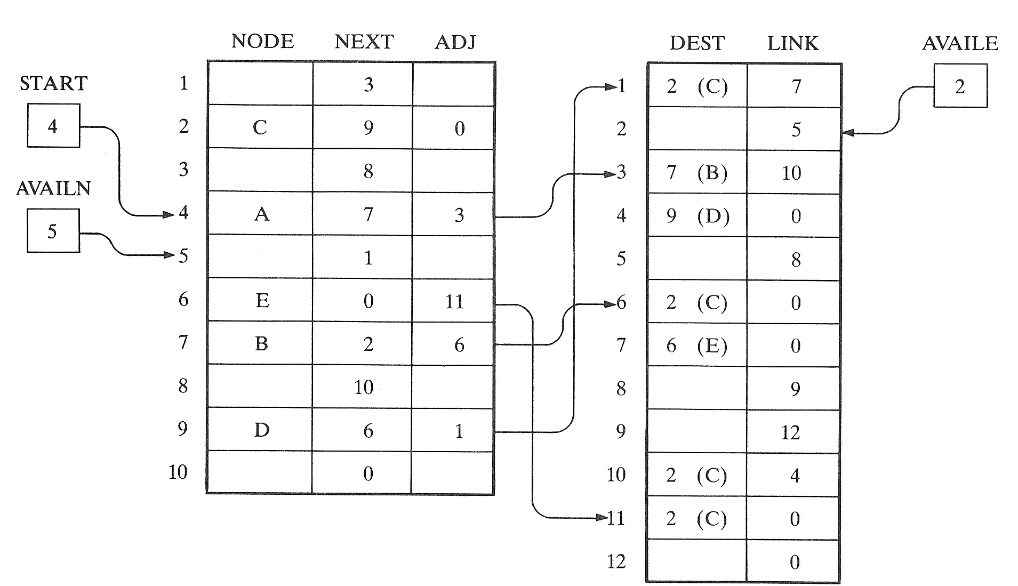
Linked Representation

Slide 46
Adjacency Multilists
Adjacency lists maintained as multilists
Multilists ➔ lists in which nodes may be shared among several lists
Exactly one node for each edge but this node will be in two lists
Notes:
In the adjacency-list representation of an undirected graph, each edge (u,v) is represented by two entries, one on the list for u and the other on the list for v. In some situations it is necessary to be able to determine the second entry for a particular edge and mark that edge as having been examined. This can be accomplished easily if the adjacency lists are actually maintained as multilists.

Slide 47

Adjacency Multilists
where
m is a boolean mark field
(may be used to check whether the edge has been examined)

Slide 48

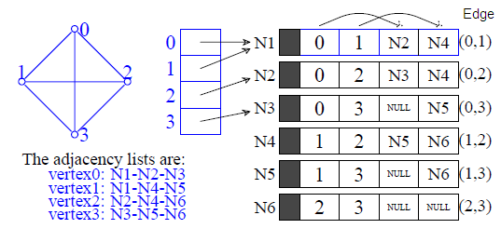
Adjacency Multilists - Example

Slide 49
Graph ADT
typedef struct vertex
{
struct vertex* pNextVertex;
void* dataPtr;
struct edge* pEdge;
}VERTEX;
typedef struct edge
{
struct vertex* destination;
struct edge* pNextEdge;
}EDGE;

Slide 50
Traversing a Graph
Breadth First Traversal
  Uses a queue as an auxiliary structure to hold nodes / vertices for future processing
Depth First Traversal
  Uses a stack as an auxiliary structure to hold nodes / vertices for future processing

Slide 51
Algorithms
During execution of algorithm each node N of G will be in one of three states
  STATUS = 1 (Ready State) – Initial state of N
  STATUS = 2 (Waiting State) – N is on the queue or stack, waiting to be processed
  STATUS = 3 (Processed State) – N has been processed

Slide 52
Breadth-first Traversal
General Idea
  Process starting node say N
  Process all neighbors of N
  Process all neighbors of neighbors of N and so on…
  No node should be processed more than once
  Use of queue to hold nodes that are waiting to be processed

Slide 53
Breadth First Traversal - Algorithm
Algorithm BreadthFirstG (graph)
Initialize all nodes to the ready state (STATUS=1)
Put the starting node N in queue (enqueue N) and change its status to the waiting state (STATUS=2)
loop(queue is not empty)
a. Remove the front node N of queue (dequeue N)
b. Process N and change the status of N to the
processed state (STATUS=3)
a. Add to the rear of queue all the neighbors of N
that are in ready state (STATUS=1)
b. Change their status to the waiting state
(STATUS=2)
end loop
end BreadthFirstG

Slide 54
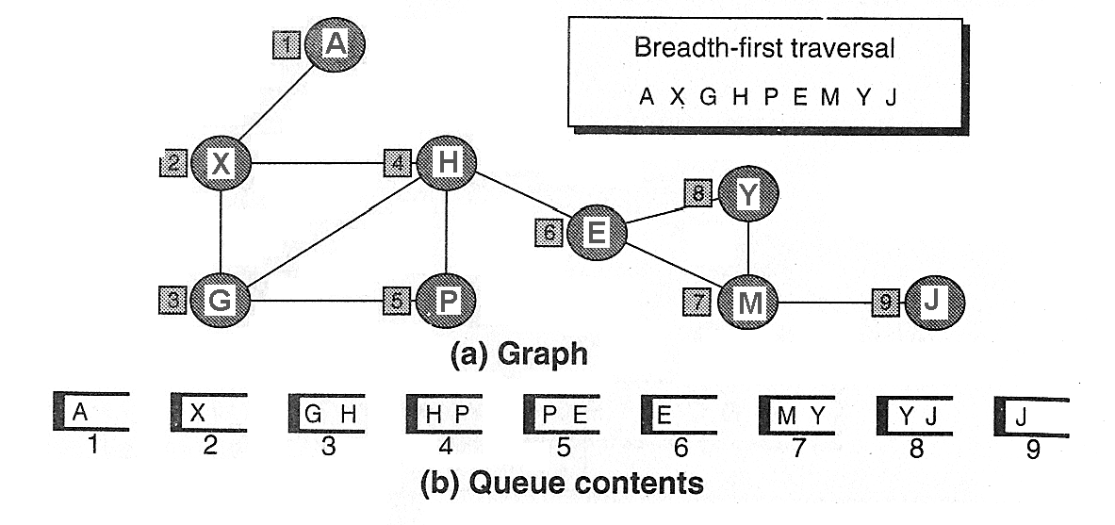
Breadth First Traversal - Example

Slide 55
Depth-first Traversal
General Idea
  Examine starting node say N
  Along path P, Examine a neighbor of N, then a neighbor of neighbor of N and so on…
  After coming to the “dead end” i.e. end of path P, backtrack on P until we can continue along another path P’ and so on…
  Use of stack to hold nodes that are waiting to be processed

Slide 56
Depth First Traversal - Algorithm
Algorithm DepthFirstG (graph)
Initialize all nodes to the ready state (STATUS=1)
Push the starting node N onto stack and change to the waiting state (STATUS=2)
loop (stack is not empty)
a. Pop the top node N of stack
b. Process N and change the status of N to the
processed state (STATUS=3)
a. Push onto stack all the neighbors of N that are still
in the ready state (STATUS=1)
b. Change their status to the waiting state
(STATUS=2)
end loop
end DepthFirstG

Slide 57
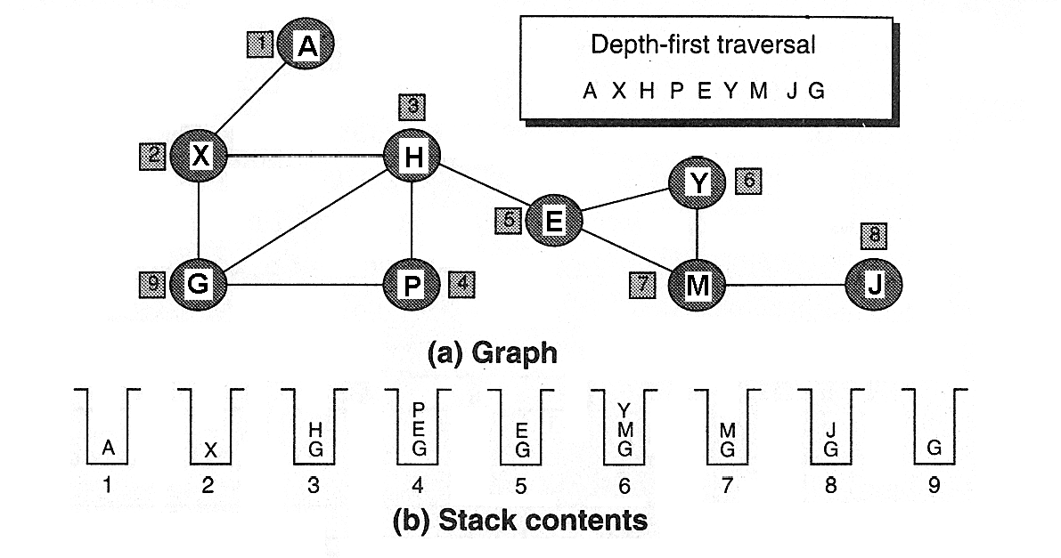
Example

Slide 58
Minimum Spanning Tree
Spanning Tree
  A tree that contains all of the vertices in the graph
Minimum Spanning Tree
  A spanning tree in which the total weight of the edges is guaranteed to be the minimum of all possible trees in the graph

Slide 59
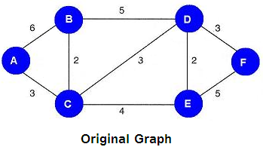
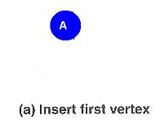
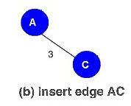
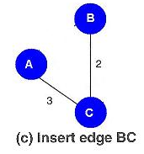
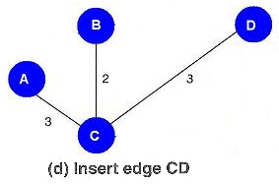
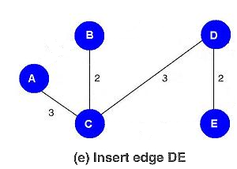
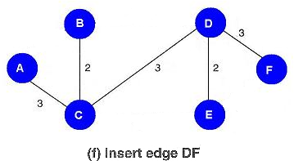
MST - Example
Notes:
Rule:
From all the vertices currently in the tree, select the edge with the minimal value to a vertex not currently in the tree and insert it into the tree.

Slide 60
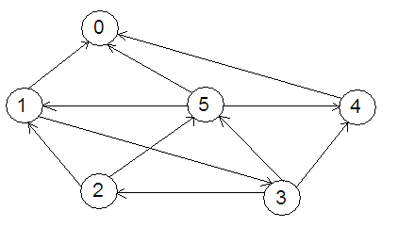
Exercise - 1
For the diagraph given below obtain
  The adjacency matrix
  The in-degree and out-degree of each vertex
  The adjacency-list representation
  The adjacency-multilist representation (assuming undirected graph)

Slide 61
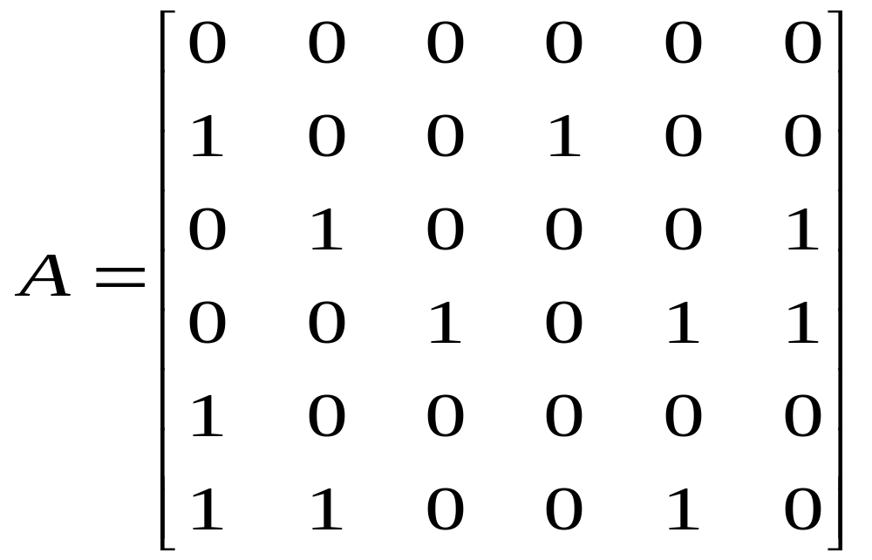
Exercise – 1 - Solution
Adjacency Matrix
0 1 2 3 4 5
0
1
2
3
4
5

Slide 62
Exercise – 1 - Solution
Node | In-degree | Out-degree
0 | 3 | 0
1 | 2 | 2
2 | 1 | 2
3 | 1 | 3
4 | 2 | 1
5 | 2 | 3

Slide 63
Exercise – 1 - Solution

Slide 64
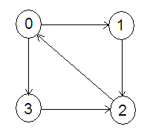
Exercise - 2
Is the graph strongly connected?
List all the simple paths.
Obtain the adjacency-matrix,
adjacency-list and
adjacency-multilist
representations
of the graph
Obtain path matrix for
the graph

Slide 65
Exercise - 3
Apply depth first and breadth first traversal to the complete graph of four vertices A, B, C, D. List the vertices in the order that they are visited.

Slide 66
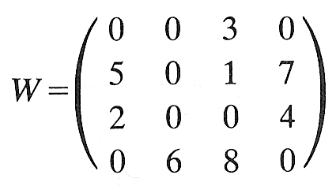
Exercise - 4
Suppose a weighted graph G is maintained in memory by a node array DATA and a weight matrix W as below. Draw a picture of G.
DATA: X, Y, S, T

Slide 67
WCE - SY (CSE) – 1CI 202: Data Structures
Course Teacher: Dr. Smriti H. Bhandari

